Slide 1
XIP Deliverables Review

Slide 2
Introduction
Purpose was to review XIP deliverables:
  Requirements
  Design
  Source
  Test
  Installation
  Running

Slide 3
XIP
An easily extensible open source platform to support image analysis and visualization
eXtensible Imaging Platform (XIP)
  Access specific post-processing applications at multiple sites simplifying clinical trials
  Increasing the uniformity of imaging and analysis
  Use of imaging as a biomarker in pharmaceutical and other clinical and research trials
  Imaging applications developed by research groups will more easily be accessible within the clinical operating environment
  Simplifying workflows and speeding data processing and analysis

Slide 4
Requirements
XIP_Req_Spec.doc for XIP release 1.0
Document stated its final update and approval at 9/2007
Still have track changes on
Still have unanswered questions

Slide 5
Design
Many design artifacts available in the form of EAP files
  WG-23_DomainModel.EAP
    Contains high level class diagram
    But many still missing
  WG-23_FileAccess_SSD.EAP
    Contains a requirements model
      One sequence diagram
No draft or final design document
  Can’t tell how all the EAP files are related
No technical-architecture guide
Is the design documentation ready to pass to a development team?

Slide 6
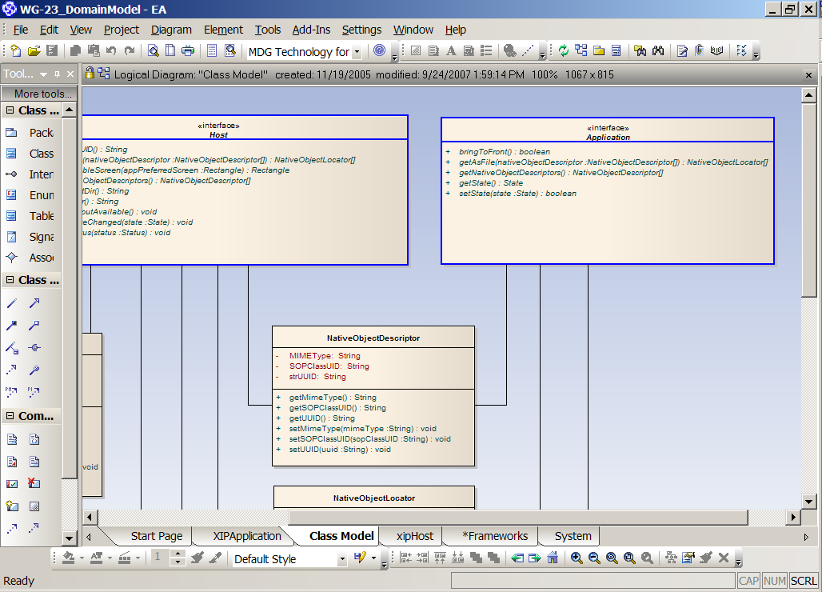
Design
Many design artifacts available in the form of EAP files
No draft or final design document

Slide 7
Source Code
Reviewed source code from:
  xipsource (XIP Application)
    Mainly in C and C++
      From Siemens Corporate Research
      Inventor
    There were some java classes but couldn’t tell who wrote them (e.g. RunIvJava.java)
  xip-reference-impl (XIPHost)
    Java classes
      WashU
      DICOM

Slide 8
Test
There is a test plan document: XIP_SE_Test_Plan.doc
  Describes the test approach and test criteria
There is a Requirements Traceability Matrix document describing requirements .vs. tests
There are test scripts for the C/C++ code
  From the XIPSource, runtest.bat (Siemens)
Couldn’t find unit test for Java classes. Couldn’t tell whether there were test scripts for Java classes.
There is no documentation for test cases or to describe the test scripts.
There are test results documents for both C/C++ and Java sources

Slide 9
Installation
Installation is easy if you were the developer
Installation guide and readme files need to be updated to reflect recent changes and upgrades
For example:
  Followed the XIP_Installation_Guide.doc to download source files
    The guide is out dated
    there was a link for downloading the xipBuilder.zip but it did not work.
      https://gforge.nci.nih.gov/plugins/scmcvs/cvsweb.php/xip/Developer/Task%202.9%20Prototype%20Code/xipbuilder.zip?cvsroot=xip
Couldn’t tell how to configure DICOM or caGrid repositories
  e.g. The xip readme file said “Data must be selected prior to any application launch. End user should select data from the local file system, query / retrieve data from the DICOM repository or caGrid repository.”
  No instructions about what data to load in the local system

Slide 10
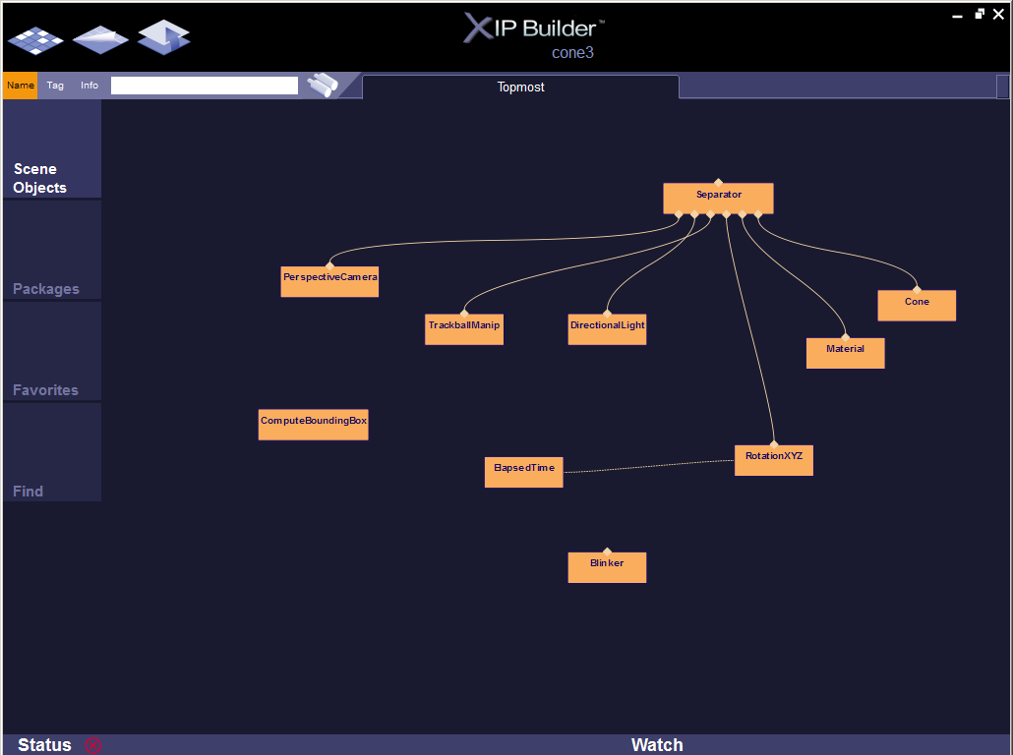
Running
XIPBuilder
It has problem reading some of .rad files.
It seems to work with the Inventor .rad files.

Slide 11
11:01:29 | Inventor error: load xipivcore.dll (The specified module could not be found.)
11:01:29 | Inventor error: load xipivcoregl.dll (The specified module could not be found.)
11:01:29 | Inventor error: load xipivdicom.dll (The specified module could not be found.)
11:01:29 | Inventor error: load xipivoverlay.dll (The specified module could not be found.)
11:01:29 | Inventor error: load xipivrenderer.dll (The specified module could not be found.)
11:01:29 | Inventor error: load xipivitk.dll (The specified module could not be found.)
11:01:29 | Inventor error: load xipivvtk.dll (The specified module could not be found.)
11:01:29 | Inventor error: load xipivremote.dll (The specified module could not be found.)
11:04:52 | Inventor read error: Expected '}'; got ']'; Occurred at line 70 in C:/biotech/cabig/image/xip-source/examples/core/two_viewports.rad
11:04:52 | Inventor read error: Expected '{'; got '"'; Occurred at line 71 in C:/biotech/cabig/image/xip-source/examples/core/two_viewports.rad
11:04:52 | Inventor read error: Expected '}'; got ']'; Occurred at line 89 in C:/biotech/cabig/image/xip-source/examples/core/two_viewports.rad
11:04:52 | Inventor read error: Expected '{'; got '"'; Occurred at line 90 in C:/biotech/cabig/image/xip-source/examples/core/two_viewports.rad
11:04:52 | Inventor read error: Couldn't read value for field "connections"; Occurred at line 94 in C:/biotech/cabig/image/xip-source/examples/core/two_viewports.rad
11:04:52 | Inventor read error: Couldn't read value for field "nodeList"; Occurred at line 97 in C:/biotech/cabig/image/xip-source/examples/core/two_viewports.rad
11:04:52 | Inventor read error: Expected '{'; got 'U'; Occurred at line 100 in C:/biotech/cabig/image/xip-source/examples/core/two_viewports.rad
11:05:07 | Inventor read error: Expected '}'; got ','; Occurred at line 40 in C:/biotech/cabig/image/xip-source/examples/dicom/load_presentationstate.rad
11:05:07 | Inventor read error: Couldn't read value for field "node"; Occurred at line 40 in C:/biotech/cabig/image/xip-source/examples/dicom/load_presentationstate.rad
11:05:07 | Inventor read error: Expected '}'; got ']'; Occurred at line 74 in C:/biotech/cabig/image/xip-source/examples/dicom/load_presentationstate.rad
11:05:07 | Inventor read error: Couldn't read value for field "node"; Occurred at line 75 in C:/biotech/cabig/image/xip-source/examples/dicom/load_presentationstate.rad
12:24:41 | Inventor read error: Couldn't read value for field "engine"; Occurred at line 24 in C:/biotech/caBIG/IMAGE/xip-source/examples/dicom/GetDicomString.rad
12:24:41 | Inventor read error: Expected '}'; got ','; Occurred at line 35 in C:/biotech/caBIG/IMAGE/xip-source/examples/dicom/GetDicomString.rad
12:24:41 | Inventor read error: Couldn't read value for field "node"; Occurred at line 36 in C:/biotech/caBIG/IMAGE/xip-source/examples/dicom/GetDicomString.rad
12:24:48 | Inventor read error: Can't open file "C:\biotech\caBIG\IMAGE\bin\release\GetDicomString.rad" for reading; Occurred at line 1 in <stdin>
12:28:29 | Inventor read error: Expected '}'; got ','; Occurred at line 22 in C:/biotech/caBIG/IMAGE/xip-source/examples/renderer/slicer/slicerWithLutShaded.rad
12:28:29 | Inventor read error: Couldn't read value for field "node"; Occurred at line 22 in C:/biotech/caBIG/IMAGE/xip-source/examples/renderer/slicer/slicerWithLutShaded.rad
12:28:29 | Inventor read error: Unknown class "SoXipExaminer"; Occurred at line 76 in C:/biotech/caBIG/IMAGE/xip-source/examples/renderer/slicer/slicerWithLutShaded.rad
12:28:29 | Inventor read error: Couldn't read value for field "node"; Occurred at line 76 in C:/biotech/caBIG/IMAGE/xip-source/examples/renderer/slicer/slicerWithLutShaded.rad
12:28:29 | Inventor read error: Unknown reference "+1"; Occurred at line 82 in C:/biotech/caBIG/IMAGE/xip-source/examples/renderer/slicer/slicerWithLutShaded.rad
12:28:29 | Inventor read error: Couldn't read value for field "engine"; Occurred at line 82 in C:/biotech/caBIG/IMAGE/xip-source/examples/renderer/slicer/slicerWithLutShaded.rad
12:28:29 | Inventor read error: Unknown reference "+1"; Occurred at line 92 in C:/biotech/caBIG/IMAGE/xip-source/examples/renderer/slicer/slicerWithLutShaded.rad
12:28:29 | Inventor read error: Couldn't read value for field "node"; Occurred at line 92 in C:/biotech/caBIG/IMAGE/xip-source/examples/renderer/slicer/slicerWithLutShaded.rad
12:28:29 | Inventor read error: Unknown reference "+1"; Occurred at line 103 in C:/biotech/caBIG/IMAGE/xip-source/examples/renderer/slicer/slicerWithLutShaded.rad
12:28:29 | Inventor read error: Couldn't read value for field "node"; Occurred at line 103 in C:/biotech/caBIG/IMAGE/xip-source/examples/renderer/slicer/slicerWithLutShaded.rad
12:28:29 | Inventor read error: Unknown reference "+1"; Occurred at line 137 in C:/biotech/caBIG/IMAGE/xip-source/examples/renderer/slicer/slicerWithLutShaded.rad
12:28:29 | Inventor read error: Unknown reference "+1"; Occurred at line 142 in C:/biotech/caBIG/IMAGE/xip-source/examples/renderer/slicer/slicerWithLutShaded.rad
12:28:29 | Inventor read error: Couldn't read value for field "node"; Occurred at line 156 in C:/biotech/caBIG/IMAGE/xip-source/examples/renderer/slicer/slicerWithLutShaded.rad
12:28:29 | Inventor read error: Unknown reference "+5"; Occurred at line 287 in C:/biotech/caBIG/IMAGE/xip-source/examples/renderer/slicer/slicerWithLutShaded.rad
12:28:29 | Inventor read error: Couldn't read value for field "node"; Occurred at line 287 in C:/biotech/caBIG/IMAGE/xip-source/examples/renderer/slicer/slicerWithLutShaded.rad

Slide 12
Notes from Final Outcome
Given the feedback from David, the XIP team updated the installation instructions, consolidating the two separate documents (for the libraries/tools and the host/sample apps) into a single overall document.
The XIP added a sample data set for the XIP Host to play with on the local file system, in addition to the links to caGRID test data services managed by OSU, and updated the installation instructions to include directions on how to launch the sample RECIST application.
Running the sample app with test data should give quick feedback that the installation happened correctly.
The installation instructions also cover administration instructions, hence XIP team did not make a separate administration guide at this time. XIP team did put a copy of the installation/administration instructions into the slot in gForge for the final admin guide.
All release notes are also now in place.
XIP team put a caBIG silver compatibility review submission package in gForge, drawing largely from existing documents coupled with an updated cover doc. Mentors were notified

